Slide 1
Netflix_Practice_2024Sept
File created on: 3/13/2025 3:54:35 PM

Slide 2
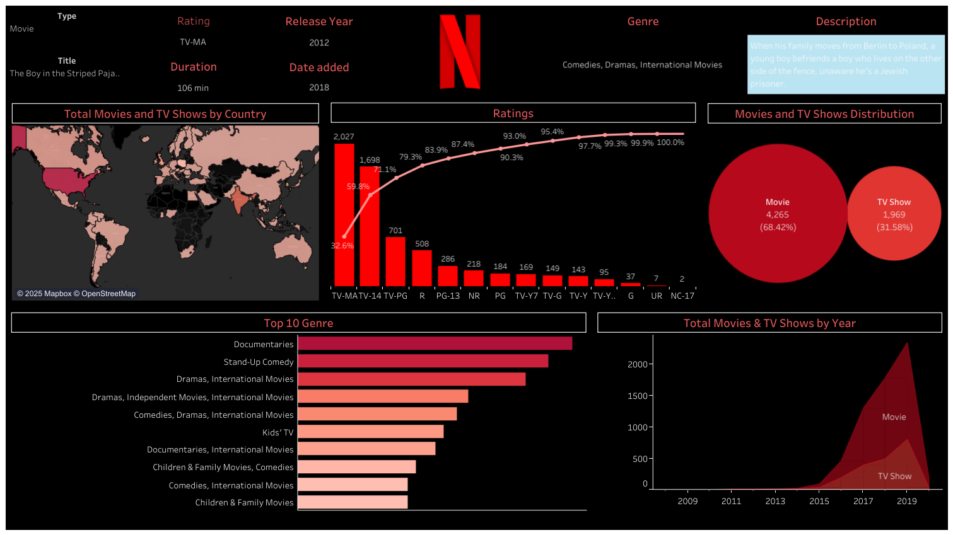

Slide 3
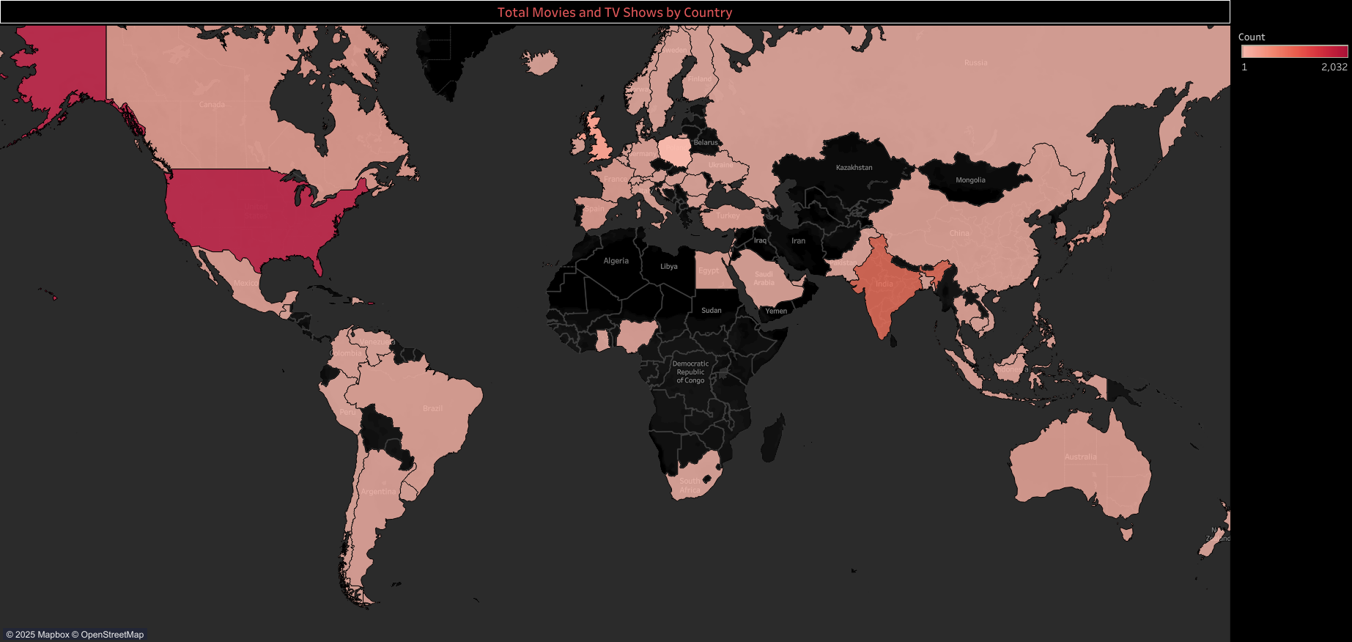

Slide 4
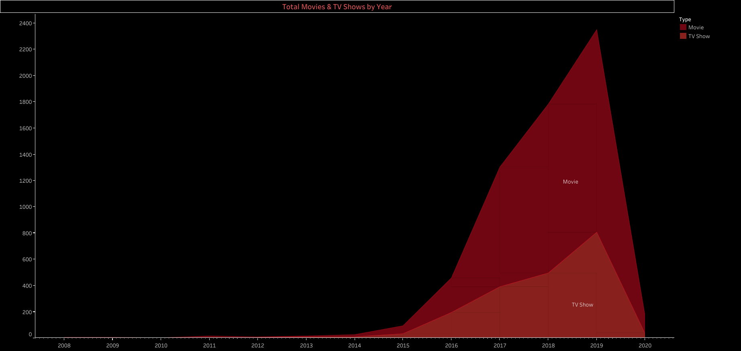

Slide 5
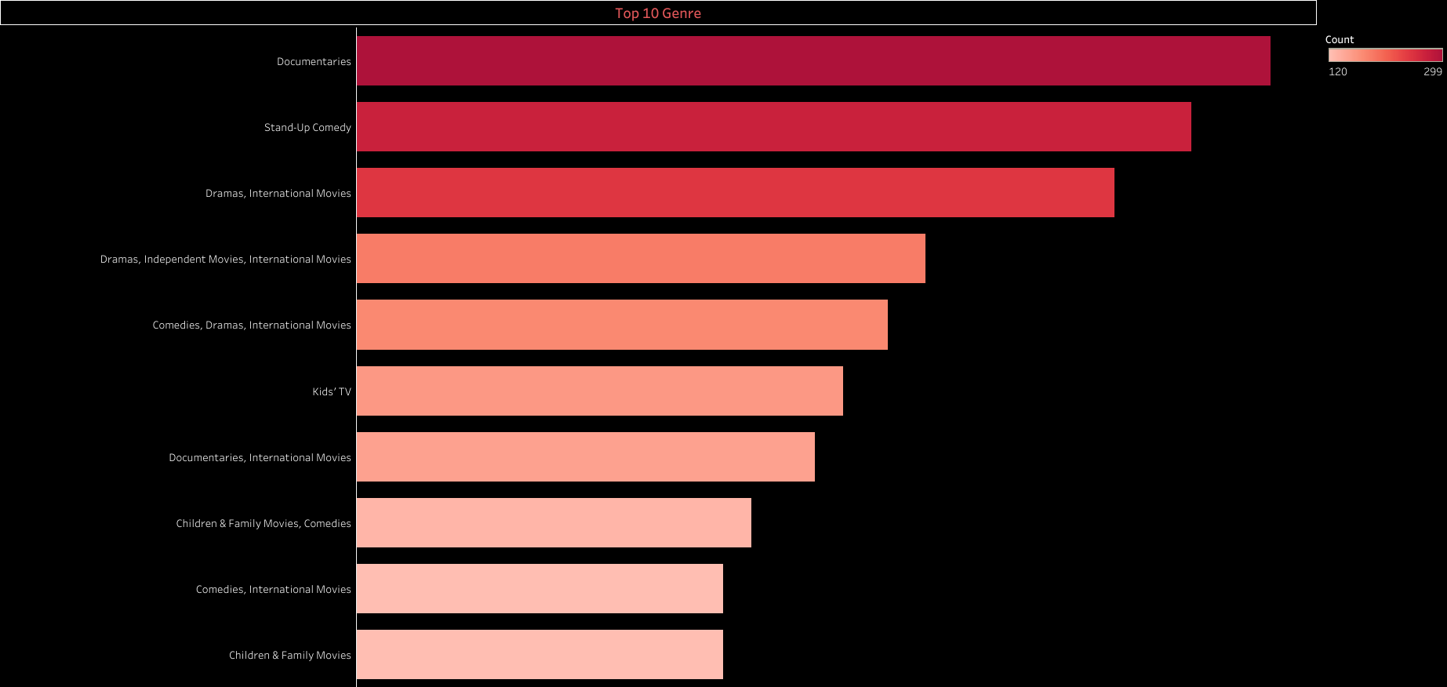

Slide 6
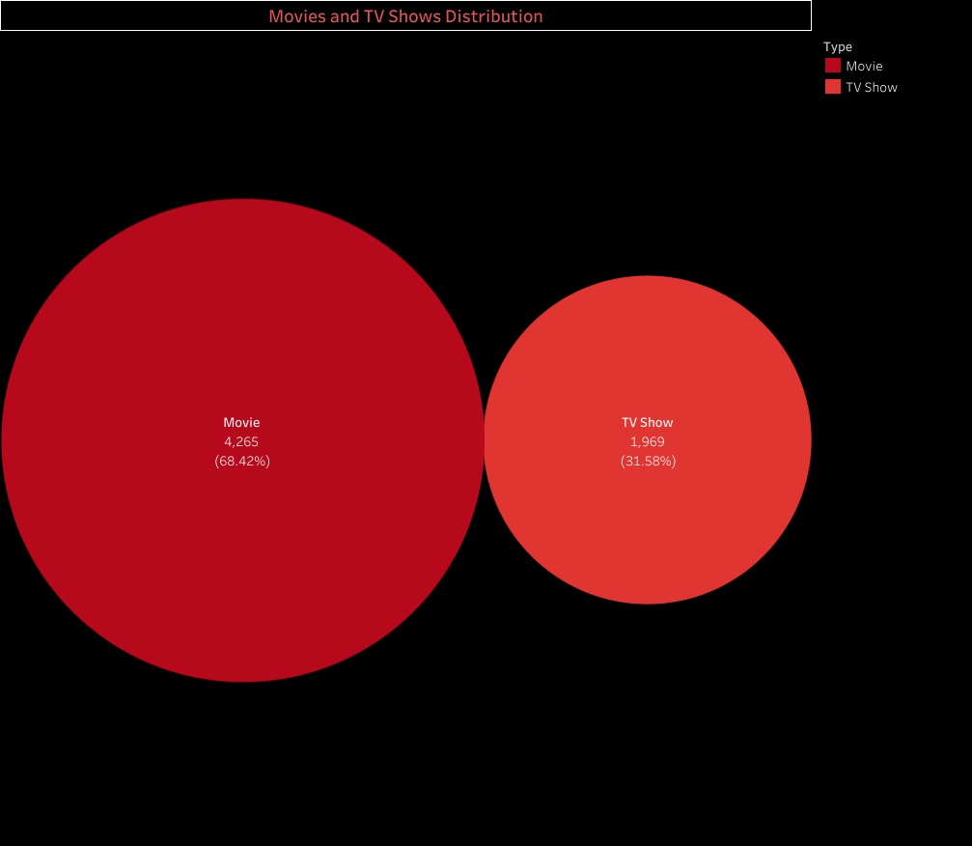

Slide 7
